Slide 1
Core Java 8 and Development Tools
Lesson 02 : Eclipse 4.4 (Luna) as an IDE

Slide 2
Lesson Objectives
After completing this lesson, participants will be able to:
Understand fundamentals of working with Eclipse
Creating and Managing Java Projects through Eclipse IDE
Use different features of Eclipse to develop rapid applications
Notes:
This lesson demonstrate the use of IDE to create Java applications with ease.
Lesson Outline:
Lesson 2: Eclipse4.4 as an IDE
2.1: Installation and setting up Eclipse
2.2: Introduction to Eclipse IDE
2.3: To create and manage Java projects
2.3.1: Debugging your Java Program
2.4: Miscellaneous options
2.4.1: Creating Jar files
2.4.2: Verifying JRE installation
2.4.3: Creating a Jar file
2.4.4: Setting Classpath
2.4.5: Passing Command line arguments
2.4.6: Import and Export Options
2.4.7: Automatic Build/Manual Build options
2.4.8: Using Javadocs
2.4.9: Tips and Tricks

Slide 3
2.1: Installation and Setting up Eclipse Installing Eclipse 4.4 (Luna)
You need to follow the given steps to install Eclipse 4.4:
Download Eclipse-SDK zip file from https://eclipse.org/downloads/
Unpack the Eclipse SDK into the target directory
For example: c:\eclipse4.4
To start Eclipse, go to the eclipse subdirectory of the folder in which you extracted the zip file (for example: c:\eclipse4.4\eclipse) and run eclipse.exe

Slide 4

2.2 : Introduction to Eclipse IDE Integrated Development Environment
IDE is an application or set of tools that allows a programmer to write, compile, edit, and in some cases test and debug within an integrated, interactive environment
IDE combines:
Editor
Compiler
Runtime environment
debugger
Notes:
What is an IDE?
The Eclipse Project is an open source software development project dedicated to providing a robust, full-featured, commercial-quality, industry platform for the development of highly integrated tools and rich client applications. Eclipse runs on Windows, Linux, Mac OSX, Solaris, AIX and HP-UX. Eclipse is actually a generic application platform with a sophisticated plug in architecture - the Java IDE is just one set of plugins. There is an active community of third party Eclipse plugin developers, both open source and commercial. Our objective is to code Java programs faster with Eclipse 4.4 as an IDE.
Eclipse4.4 features include the following:
Creation and maintenance of the Java project
Developing Packages
Debugging a java program with variety of tools available
Running a Java program
Developing the Java program will be easier as Eclipse editor provides the following:
Syntax highlighting
Content/code assist
Code formatting
Import assistance
Quick fix

Slide 5
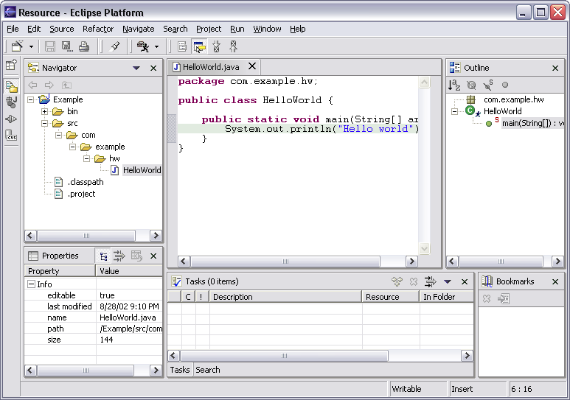
2.2 : Introduction to Eclipse IDE Workbench Terminology
Menu bar
Tool bar
Text
editor
Perspective
and
Fast View
bar
Outline
view
Resource
Navigator
view
Bookmarks
view
Properties
view
Message
area
Editor
Status
area
Stacked
views
Tasks
view

Slide 6
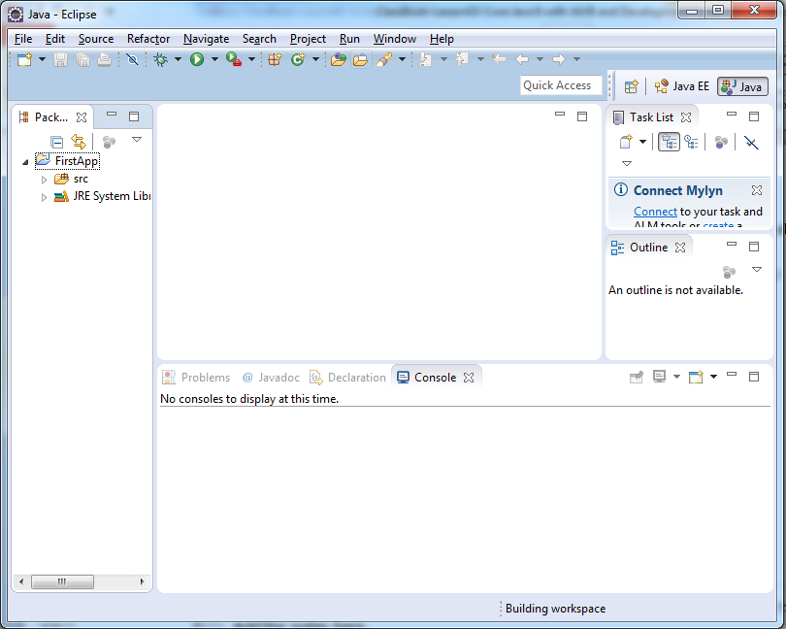
2.2 : Introduction to Eclipse IDE The Workbench
The term “Workbench” refers to the desktop development environment
It allows you to select the Workspace
A Workbench consists of the following:
perspectives
views
editors

Slide 7
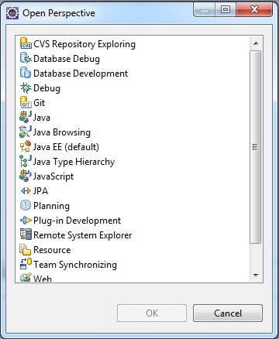
2.2 : Introduction to Eclipse IDE The Workbench
Perspective:
A perspective defines the initial set and layout of views in the Workbench window
Workbench offers one or more Perspectives
A perspective contains editors and views, such as the Navigator
By default the Java perspective is selected
The title bar indicates which perspective is open
Notes:
The Workbench:
The term Workbench refers to the desktop development environment.
Perspectives:
Each Workbench window contains one or more perspectives. Perspectives contain views and editors and control what appears in certain menus and tool bars. They define visible action sets, which you can change to customize a perspective. You can save a perspective that you build in this manner, making your own custom perspective that you can open again later. By default the Java perspective is selected.
Each perspective provides a set of functionality aimed at accomplishing a specific type of task or works with specific types of resources. For example: The Java perspective combines views that you would commonly use while editing Java source files, while the Debug perspective contains the views that you would use while debugging Java programs. As you work in the Workbench, you will probably switch perspectives frequently.

Slide 8
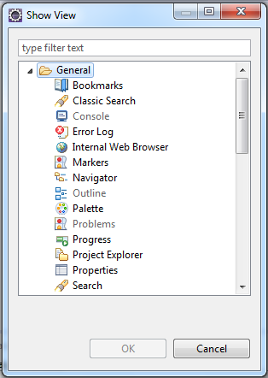
2.2 : Introduction to Eclipse IDE The Workbench
View:
It is the visual component within the Workbench
It is used to navigate a hierarchy of information or display properties for the active editor
Notes:
The Workbench:
View:
Views support editors and provide alternative presentations as well as ways to navigate the information in your Workbench. For example: The Project Explorer and other navigation views display projects and other resources that you are working with.
Perspectives offer pre-defined combinations of views and editors. To open a view that is not included in the current perspective, select Window → Show View from the main menu bar.

Slide 9
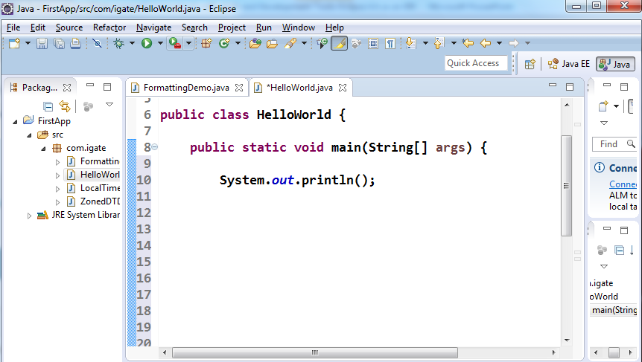
2.2 : Introduction to Eclipse IDE The Workbench
Editor:
It is the visual component within the Workbench
It is used to edit or browse a resource
Notes:
The Workbench:
Editor: Most perspectives in the Workbench comprise an editor area and one or more views. You can associate different editors with different types of files.
For example: When you open a file for editing by double-clicking it in one of the navigation views, the associated editor opens in the Workbench.
If there is no associated editor for a resource, then the Workbench attempts to launch an external editor outside the Workbench.
For example: Suppose you have a .doc file in the Workbench, and Microsoft Word is registered as the editor for .doc files in your operating system. Then opening the file will launch Word as an OLE document within the Workbench editor area.

Slide 10
2.2 : Introduction to Eclipse IDE The Workbench
Notes page
Notes:
The Workbench:
The Workbench menu bar and toolbar will be updated with options for Microsoft Word).
Any number of editors can be open at once. However, only one can be active at a time. The main menu bar and toolbar for the Workbench window contain operations that are applicable to the active editor.
Useful Tips and Tricks related with Work Bench:
View all Keyboard shortcuts: While working with your favorite editors and views in Eclipse, just press Ctrl+Shift+L to see a full list of the currently available key bindings.
Importing Files: You can quickly import files and folders into your workspace by dragging them from the file system (for example: from a Windows Explorer window) and dropping them into the Project Explorer view. The files and folder are always copied into the project. The originals are not affected. Copy and paste also work.
Exporting Files: You can drag files and folder from the Project Explorer view to the file system (e.g., to a Windows Explorer window) to export the files and folders. The files and folder are always copied. However, the workspace resources are not affected. Copy and paste also work.
Switch Workspace: Instead of shutting down eclipse and restarting with a different workspace, you can instead use File → Switch Workspace. From here you can either open previous workspaces directly from the menu or you can open the workspace chooser dialog to choose a new one.

Slide 11
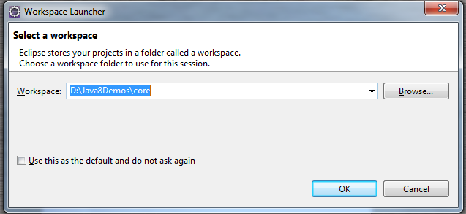
2.3: Creating and Managing Java Projects Create Workspace
You need to follow the given steps to create a workspace:
Start up Eclipse
Supply a path to a new folder which will serve as your workspace
The workspace is a folder which Eclipse uses to store your source code

Slide 12
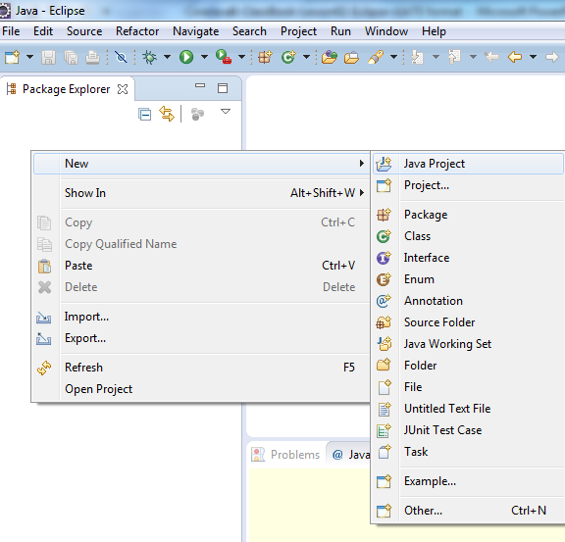
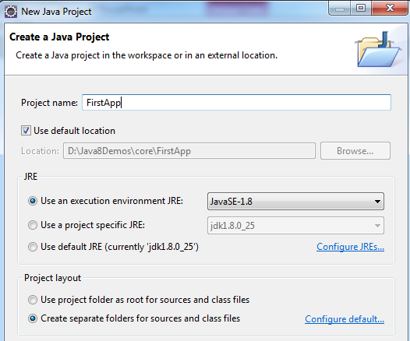
2.3: Creating and Managing Java Projects Create a Java Project
Right-click the Package Explorer panel, and select New-JavaProject.
Select Java project and provide a Project Name.
Notes:
Creating and Managing Java Projects:
Create a Java Project:
When Eclipse starts, you will see the Welcome page. Close the Welcome page.
Right-click in the Package Explorer panel, and select New → JavaProject and provide a Project name.
Note:
The name of the project is FirstApp. It is created in the workspace which you have selected in the beginning.
The Project uses jre1.8.0_25. The same folder will be used for storing both the source files and the class files.
The Java project can now include the following:
Class
Package
Interface
Source folder
Folder
File
Junit Test Case
Other - which may include other resources as text files

Slide 13
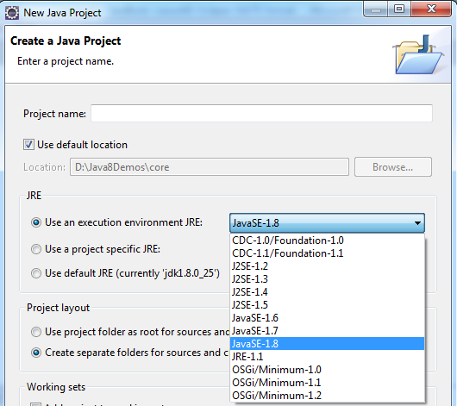
2.3: Creating and Managing Java Projects Select the JRE
In order to develop code compliant with Java SE 8, you will need a JavaSE-1.8 Java Runtime Environment (JRE)
Notes:
Creating and Managing Java Projects:
Select the JRE:
To use the new Java SE 1.8 features, you must be working on a project that has a 1.8 compliance level enabled and has a 1.8 JRE. New projects will automatically get 1.8-compliance while choosing a 1.8 JRE on the first page of the New Java Project wizard.
Depending on the type of file that is being edited, the appropriate editor is displayed in the editor area.
For example: If a .TXT file is being edited, a text editor is displayed in the editor area.

Slide 14
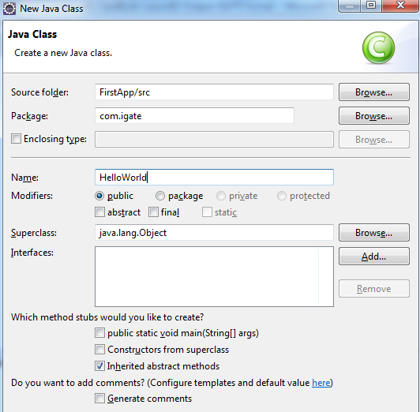
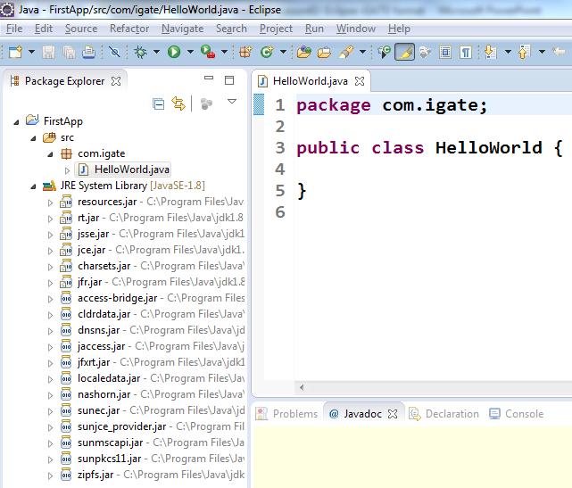
2.3: Creating and Managing Java Projects My first Java Program – Hello World
Right-click on the project and select "New->Class” Type in your Program code
Notes:
Creating and Managing Java Projects:
My first Java Program – Hello World:
If you want to create some new Java code, right-click the project and select “New → Class”.
In the dialog box created, give a name for the Java program in the Name textbox.
Also notice that a package name is also given, as the usage of default package is discouraged. A package in Java is a group of classes which are often closely or logically related in some way. (The Package chapter is discussed later in the course).
Eclipse will generate skeleton of the class including default constructor.
Note:
The package name is com.igate.
The Java program’s name is HelloWorld.
The HelloWorld class will have the public access modifier.
The HelloWorld class inherits from java.lang.Object.
Developing the Java program will be easier as Eclipse editor will provide:
Syntax highlighting
Content/code assist
Code formatting
Import assistance
Quick fix

Slide 15
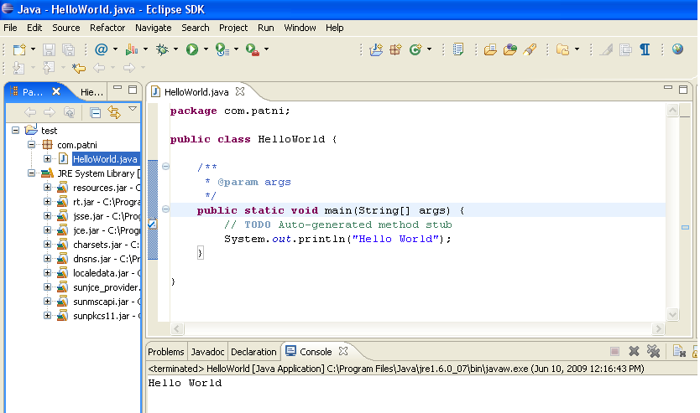
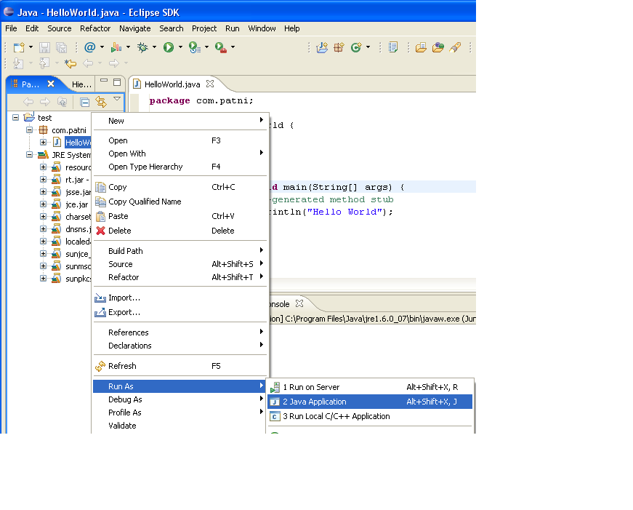
2.3: Creating and Managing Java Projects Executing Hello World Program
Right-click the program and select Run As-Java Application.
Output
Notes:
Creating and Managing Java Projects:
Executing Hello World Program:
Right-click the HelloWorld.java in the Package Explorer, and select Run As → Java Application.
The program after execution produces the output in the Console view.
Running class from the Package Explorer as a Java Application uses the default settings for launching the selected class, and does not allow you to specify any arguments.

Slide 16
2.3: Creating and Managing Java Projects Demo
HelloWorld Program using Eclipse IDE

Slide 17
2.3: Creating and Managing Java Projects Debugging your Java Program using Eclipse
The Java Development Toolkit (JDT) includes a debugger that enables you to detect and diagnose errors in your programs running either locally or remotely
The debugger allows you to control the execution of your program by employing the following:
setting breakpoints, suspending launched programs, stepping through your code, and examining the contents of variables

Slide 18
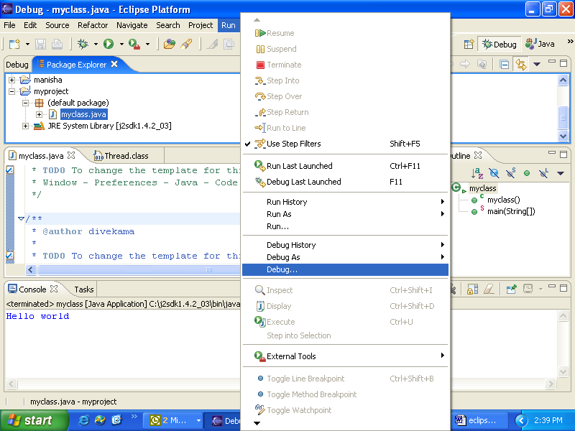
2.3: Creating and Managing Java Projects Debugging your Java Program using Eclipse
Notes:
Creating and Managing Java Projects:
Debugging a Java Program:
Eclipse gives you auto-build facility, where recompilation of the necessary Java classes is done automatically.
To debug your Java program, select the Java source file which needs to be debugged, select Run → Debug. This will ask you to select an option to halt in public static void main() method, from where you may select to step into each and every function you come across or step over every function and only capture output of each function.

Slide 19
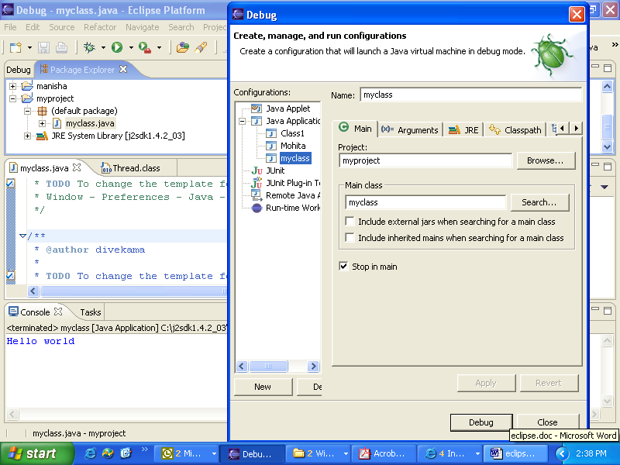
2.3: Creating and Managing Java Projects Specifying Debugging options
Notes:
Note: Click Debug to start debugging process.

Slide 20
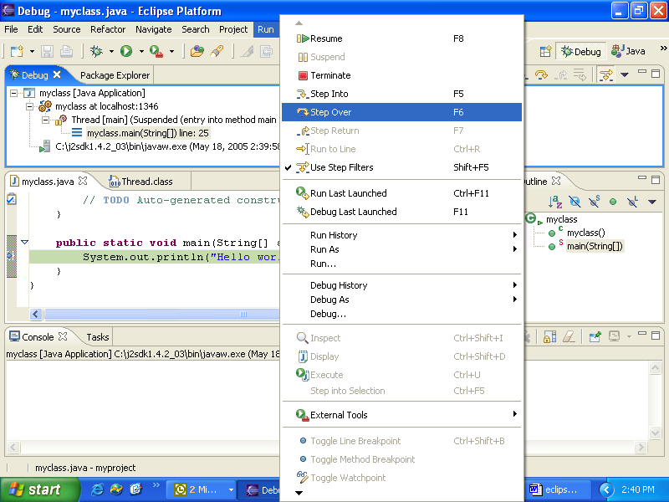
2.3: Creating and Managing Java Projects Debugging a Java Program
Notes:
Creating and Managing Java Projects:
Debugging a Java Program:
Debugging can be attained by stepping-into or stepping-over the statements.
Step-into will traverse through each and every statement in a function.
Step-over will generate output after the function call is over.
Tracing and watching the variable values is available as different debug views.

Slide 21
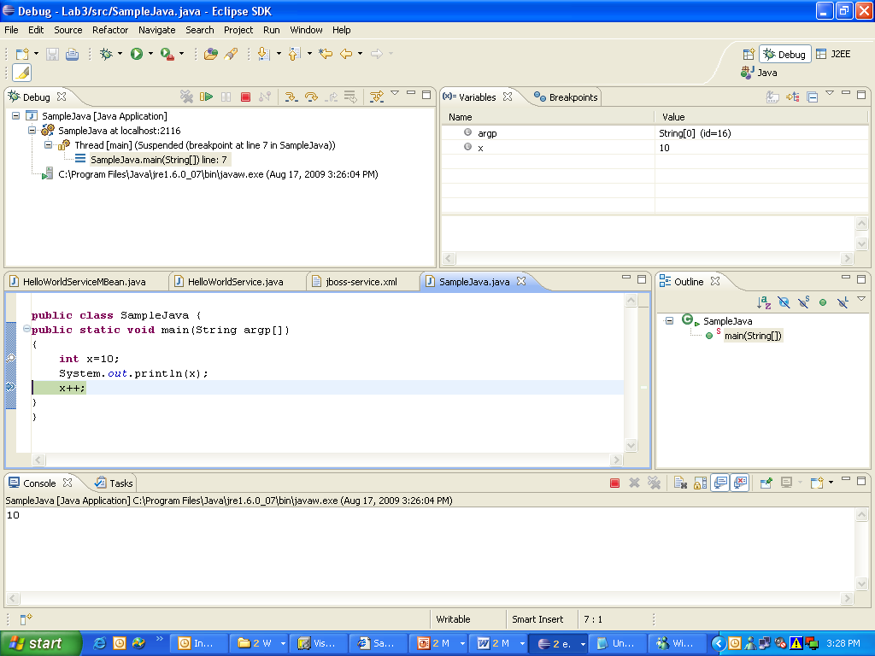
2.3: Creating and Managing Java Projects Debugging a Java Program
Notes:
Creating and Managing Java Projects:
Debugging a Java Program:
You may launch your Java programs from the workbench. The programs may be launched in either run or debug mode.
In run mode, the program executes. However, the execution may not be suspended or examined.
In debug mode, execution may be suspended and resumed, variables may be inspected, and expressions may be evaluated.
Variables view gives contents of the program variables at different statements in execution.
Breakpoints can be set for debugging, by opening the marker-bar pop-menu and selecting Toggle Breakpoint. While the Breakpoint is enabled, the thread execution suspends before the execution of the line happens. Breakpointing is a technique to set-up the starting point for program debugging.

Slide 22
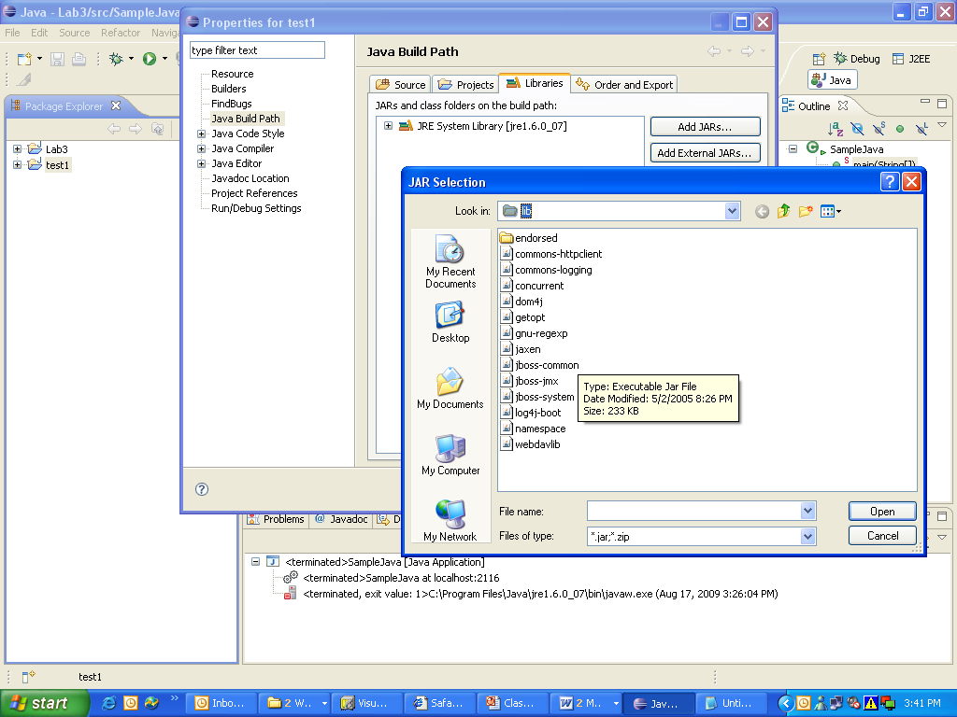
2.4: Miscellaneous Options Adding external jar file
Notes:
Miscellaneous Options:
Adding an external jar file:
When you are developing advanced Java programs, you might have to include some external jar files.
Click Project Properties.
Select Java build Path.
Click the Libraries tab, and click the Add External Jar Files button.
Locate the folder which contains the jar files, and click Open.

Slide 23
2.4: Miscellaneous Options Verifying / Changing JRE Installation
Changing the JRE is a common need while working with Eclipse which can be achieved as follows:
Select the menu item Window → Preferences to open the workbench preferences
Select Java → Installed JREs in tree pane on the left, to display the Installed Java Runtime Environments preference page
To add a new JRE, click the Add button, and select the new JRE home directory
Change the appropriate compiler.
Select Java → Compiler and select the appropriate compiler

Slide 24
2.4: Miscellaneous Options Jar File Creation
In the Package Explorer, you can optionally pre-select one or more Java elements to export
Select Export from either the Context menu or from the File menu
Expand the Java node, and select JAR file, and click Next
On the JAR File Specification page, select the resources that you want to export
Specify a name to the JAR file
Click Finish to create the JAR file

Slide 25
2.4: Miscellaneous Options Class path Setting
Classpath variables allow you to avoid references to the location of a JAR file on your local file system
Classpath variables can be used in a Java Build Path to avoid a reference to the local file system
The value of such variables is configured at the following path:
Window → Preferences → Java → Build Path → Classpath Variables
Notes:
Miscellaneous Options:
Setting Classpath:
Command Description
New... It adds a new variable entry. In the resulting dialog, specify a name and path for the new variable. You can click the File or Folder buttons to browse for a path.
Edit... It allows you to edit the selected variable entry. In the resulting dialog, edit the name and/or path for the variable. You can click the File or Folder buttons to browse for a path.
3. Remove… It removes the selected variable entry.

Slide 26
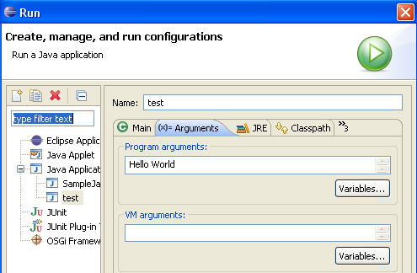
2.4: Miscellaneous Options Passing Command Line Arguments
Command line arguments can be passed to the program in the following ways:
Select Run → Open Run dialog → Arguments tab
Notes:
Note: In the snapshot shown in the above slide, there are two arguments “Hello” and “World”.

Slide 27
2.4: Miscellaneous Options Import a Project
To import an existing project to the workspace:
Go to File → Import
Select Existing Projects into Workspace option
Select the radio button next to Select archive file, and click the Browse button
Find the archive file on your hard disk and click Open to select
If you have selected an archive file containing an entire Eclipse project, then the project name will appear in the box below, that is already checked
Click Finish to perform the import
Notes:
Import and Export Options:
Import a Project:
The snapshots of the above steps are given below:

Slide 28
2.4: Miscellaneous Options Import a Project
Notes Page
Notes:
Import and Export Options:
Import a Project (contd.):
Importing Files into Project
Files can be imported into the Workbench either by:
Dragging and dropping from the file system, or
Copying and pasting from the file system, or
Using the Import wizard
Using drag and drop or copy and paste to import files relies on operating system support and that is not necessarily available on all platforms. If the platform you are using does not have this support, then you can always use the Import wizard.

Slide 29
2.4: Miscellaneous Options Build options
By default, builds are performed automatically when you save resources
Two types of Build are available, namely:
Auto Build: By selecting Project → Build automatically
Manual build: By deselecting Project → Build automatically
It is desirable in cases where you know building should wait until you finish a large set of changes
To build all the resources from the scratch you have to select Project → Clean
Notes:
Builds:
Builders create or modify workspace resources, usually based on the existence and state of other resources. They are a powerful mechanism for enforcing the constraints of some domain. For example: A Java builder converts Java source files (.java files) into executable class files (.class files), a web link builder updates links to files whose name/location have changed, and so on.
As resources are created and modified, builders are run and the constraints are maintained. This transform need not be one to one. For example: A single .java file can produce several .class files.

Slide 30
2.4: Miscellaneous Options Build options
Notes Page
Notes:
Auto-build versus Manual Build:
There are two distinct user work modes with respect to building:
Auto-build
User initiated manual build
If you do not need fine-grained control over when builds occur, you can turn on auto-building. By keeping auto-building on, builds occur after every set of resource changes (for example, saving a file, importing a ZIP, ...). Auto-building is efficient because the amount of work done is proportional to the amount of change done. The benefit of auto-building is that your derived resources (for example, Java .class files) are always up to date. Auto-building is turned on/off via the Build automatically option accessed as Project → Build automatically option.
If you need more control over when builds occur, you can turn off auto-building and invoke builds manually. This is sometimes desirable in cases where, for example, you know building is of no value until you finish a large set of changes. In this case, there is no benefit in paying the cost of auto-building.
Auto-building always uses incremental building for efficiency.
A clean build (Project → Clean) discards any existing built state. The next build after a clean will transform all resources according the domain rules of the configured builders.

Slide 31
2.4: Miscellaneous Options General Tips and Tricks
Creating Getters and Setters:
To create getter and setter methods for a field:
Select the field’s declaration
Invoke Source → Generate Getter and Setter
Content assist:
Content assist provides you with a list of suggested completions for partially entered strings
In the Java editor, press CTRL+SPACE or invoke Edit → Content Assist
Notes:
Miscellaneous Options:
Tips and Tricks:
Creating getters and Setters :
Select the field’s declaration, and invoke Source → Generate Getter and Setter.

Slide 32
2.4: Miscellaneous Options General Tips and Tricks
Source menu contains a lot of options which can be used during code generation:
Code Comments: You can quickly add and remove comments in a Java expression
Import Statements: You can use it to clean up unresolved references, add import statements, and remove unneeded ones
Method Stubs: You can create a stub for an existing method by dragging it from one class to another

Slide 33
2.4: Miscellaneous Options General Tips and Tricks
Try / Catch statements: You can create Try / Catch block for expression by Source → Surround with try/catch
Javadoc Comments: You can generate Javadoc comments for classes and methods with Source → Add Javadoc Comment
Superclass constructor: Add the superclass constructors with Source → Add Constructor from Superclass

Slide 34
2.4: Miscellaneous Options Using Java documentation
For new developers, to quickly get familiar with the Java API, Java provides API documentation.
The documentation also provides description and examples for all methods of each class.
It can be downloaded from http://docs.oracle.com/javase/8/docs/api/ for offline access.
To see Java documentation for any class or method, eclipse provides “javadoc” view.
To enable this view, select Windows → Show View → Javadoc.
You can also view the javadoc contents in HTML format by using shortcut key “Shift + F2”.
Notes:
Using Java documentation:
Java API provides documentation which is good resource to get familiar with it. This documentation is valuable resource for programmers wishing to construct the applications in Java.
The documentation provides all information about the Java API. It includes list of classes or objects available to programmer.
Javadoc View:
Eclipse provides the javadoc view which shows the available documentation for selected class or method. To enable this view, select Windows → Show View → Javadoc.

Slide 35
Lab
Lab 1: Working with Java & Eclipse

Slide 36
Summary
In this lesson, you have learnt:
The method to install Eclipse
Process to create a Java Project with Eclipse
Various useful features of Eclipse

Slide 37
Review Question
Question 1: Which of the following are true with Eclipse 4.4?
Option 1: A Java Project in Eclipse has got a Java builder that can incrementally compile Java source files as they are changed
Option 2: A workspace can have one project only
Option 3: The source and class files can be kept in different folders
Question 2: To build all resources, even those that have not changed since the last build, you have to select the following option:
Option1: Project → Build Project
Option2: Project → Build All
Option3: Project → Clean
Notes:
Add the notes here.

